Slide 1

CSE- 321
Software Engineering
Lecture :20 Software Maintenance
Fahad Ahmed
Lecturer, Dept. of CSE
E-mail: fahadahmed@uap-bd.edu

Slide 2
Lecture Outlines
Software Maintenance
Need for Maintenance
Types of Software Maintenance
Causes of Software Maintenance Problems
Software Maintenance Cost Factors
Software Re-engineering

Slide 3


Software Maintenance

Slide 4
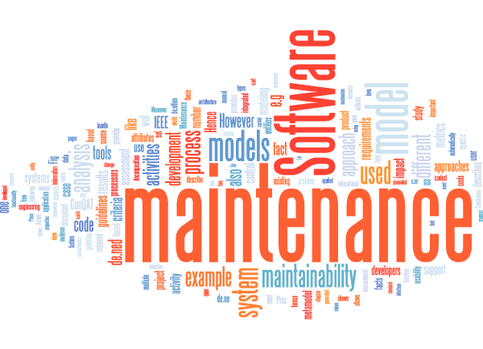
Software Maintenance
Software Maintenance is the process of modifying a software product after it has been delivered to the customer.
The main purpose of software maintenance is to modify and update software application after delivery to correct faults and to improve performance.

Slide 5
Need for Maintenance
Software Maintenance is required to ensure that the system continues to satisfy user requirements:-
Correct errors
Change in user requirement with time
Changing hardware/software requirements
To improve system efficiency
To optimize the code to run faster
To modify the components
To reduce any unwanted side effects.

Slide 6
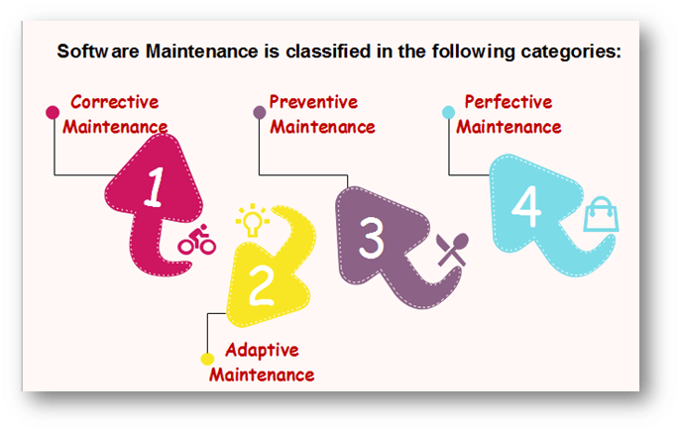
Types of Software Maintenance

Slide 7
Types of Software Maintenance
Maintenance can be divided into the following:
Corrective maintenance: Corrective maintenance of a software product may be essential either to rectify some bugs observed while the system is in use, or to enhance the performance of the system.
Adaptive maintenance: This includes modifications and updates when the customers need the product to run on new platforms, on new operating systems, or when they need the product to interface with new hardware and software.
Perfective maintenance: A software product needs maintenance to support the new features that the users want or to change different types of functionalities of the system according to the customer demands.
Preventive maintenance: This type of maintenance includes modifications and updates to prevent future problems of the software. It goals to attend problems, which are not significant at this moment but may cause serious issues in future.

Slide 8
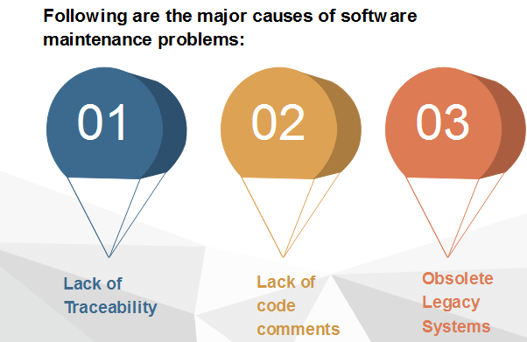
Causes of Software Maintenance Problems

Slide 9
Causes of Software Maintenance Problems
Lack of Traceability
Codes are rarely traceable to the requirements and design specifications.
It makes it very difficult for a programmer to detect and correct a critical defect affecting customer operations.
Like a detective, the programmer pores over the program looking for clues.
Life Cycle documents are not always produced even as part of a development project.
Lack of Code Comments
Most of the software system codes lack adequate comments. Lesser comments may not be helpful in certain situations.

Slide 10
Causes of Software Maintenance Problems
Obsolete Legacy Systems
In most of the countries worldwide, the legacy system that provides the backbone of the nation's critical industries, e.g., telecommunications, medical, transportation utility services, were not designed with maintenance in mind.
They were not expected to last for a quarter of a century or more.
As a consequence, the code supporting these systems is devoid of traceability to the requirements, compliance to design and programming standards and often includes dead, extra and uncommented code, which all make the maintenance task next to the impossible.

Slide 11
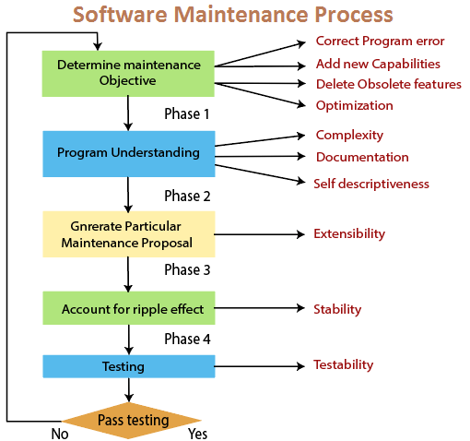
Causes of Software Maintenance Problems

Slide 12
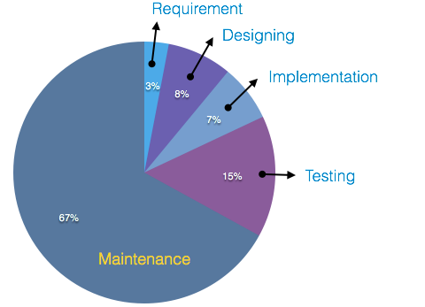
Software Maintenance Cost Factors
A study on estimating software maintenance found that the cost of maintenance is as high as 67% of the cost of entire software process cycle.
There are two types of cost factors involved in software maintenance.
These are
Non-Technical Factors
Technical Factors

Slide 13
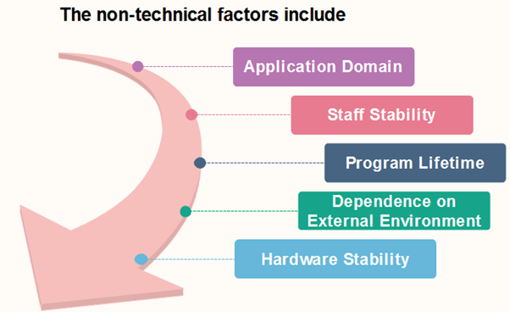
Software Maintenance Cost Factors

Slide 14
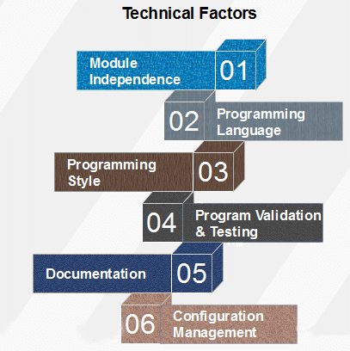
Software Maintenance Cost Factors

Slide 15
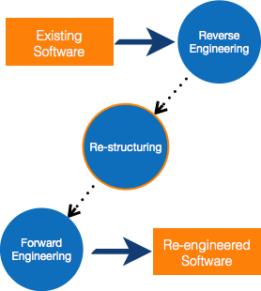
Software Re-engineering
When we need to update the software to keep it to the current market, without impacting its functionality, it is called software re-engineering. It is a thorough process where the design of software is changed and programs are re-written.

Slide 16

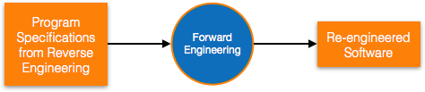
Re-Engineering Process
Reverse Engineering Reverse Engineering is processes of extracting knowledge or design information from anything man-made and reproducing it based on extracted information. It is also called back Engineering.
Forward Engineering
Forward engineering is a process of obtaining desired software from the specifications in hand which were brought down by means of reverse engineering. It assumes that there was some software engineering already done in the past.

Slide 17
Re-Engineering Process
Why Reverse Engineering?
Providing proper system documentation.
Recovery of lost information.
Assisting with maintenance.
Facility of software reuse.
Discovering unexpected flaws or faults
Used of Software Reverse Engineering –
Software Reverse Engineering is used in software design, reverse engineering enables the developer or programmer to add new features to the existing software with or without knowing the source code.
Reverse engineering is also useful in software testing, it helps the testers to study the virus and other malware code .

Slide 18

Thanks to All

